Slide 1
Slac Trip B Sample Information Sheet
Created: 1.21.2017

Slide 2
Informational Sheets
These sheets list the ternary map and the compositional diagram. On each compositional diagram, the flat is on the left. The element of each composition diagram is listed next to its corresponding color bar.
All samples have their index number scribed on the back center of the sample, and a Roman numeral 2 directly under the flat, to indicate that they are the second (B) batch of samples.
Composition predictions were made using an in-house sputtering prediction model

Slide 3
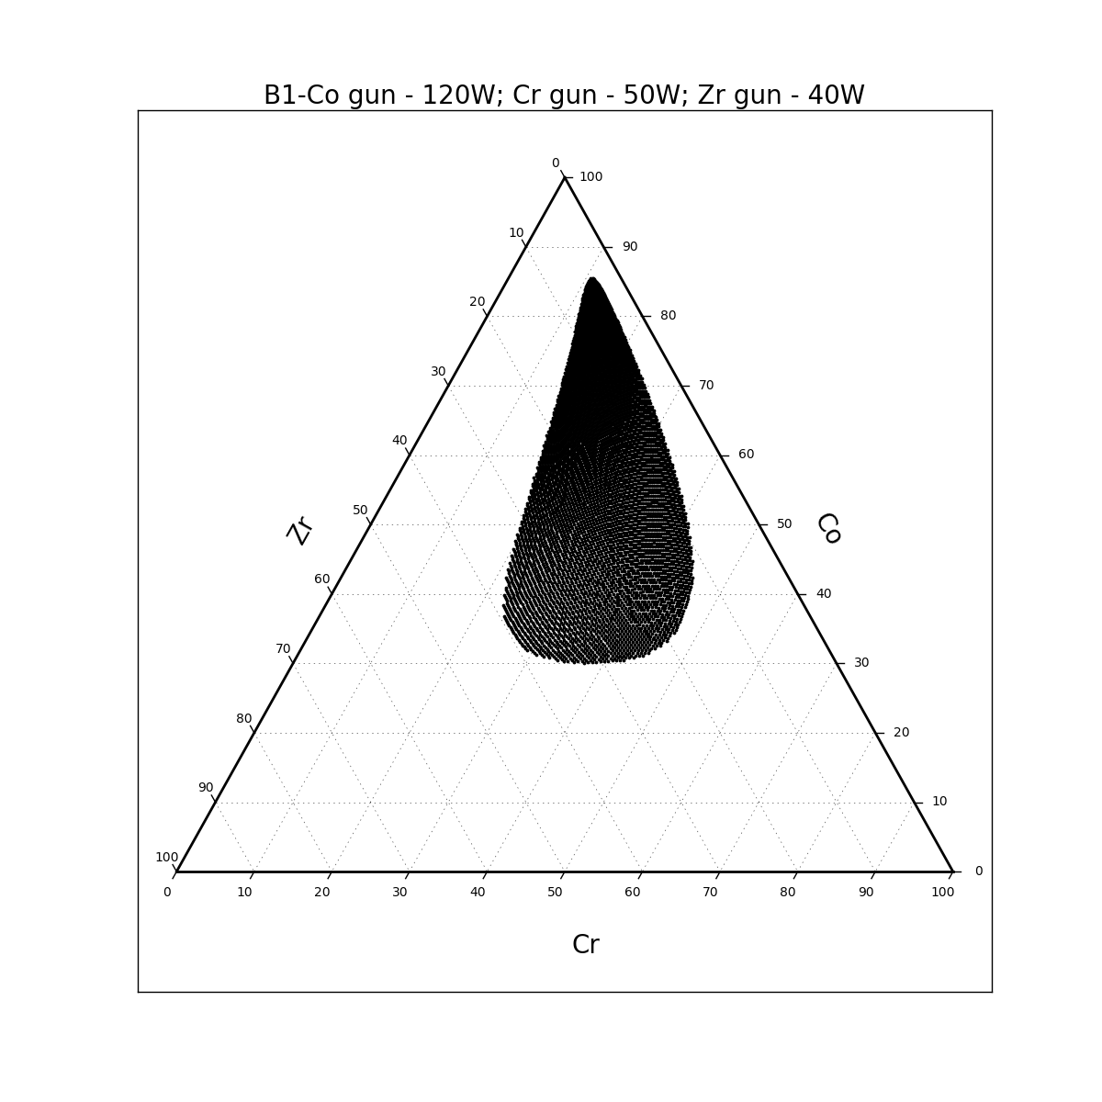
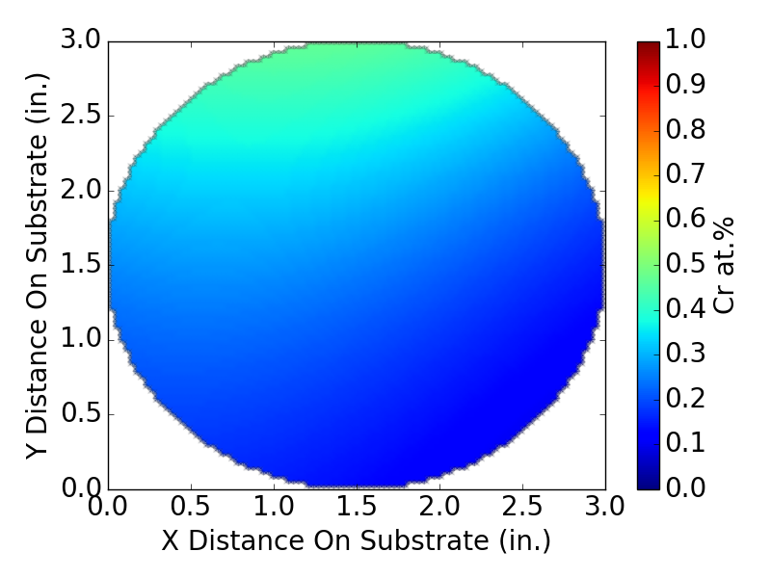
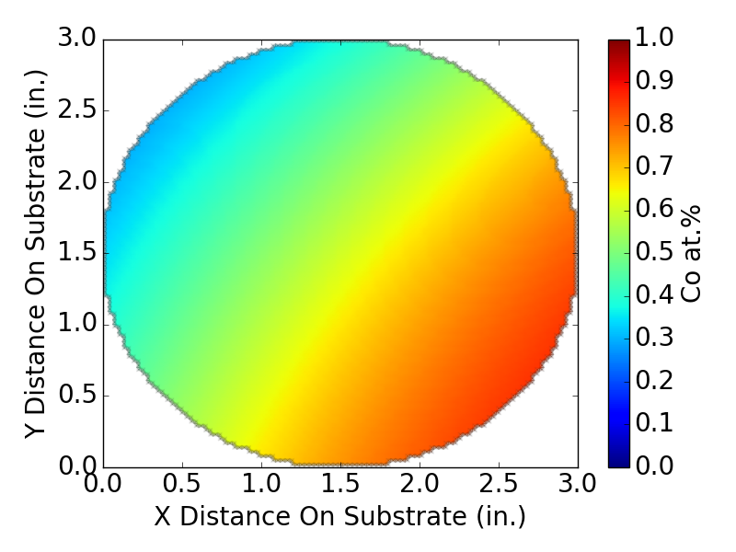
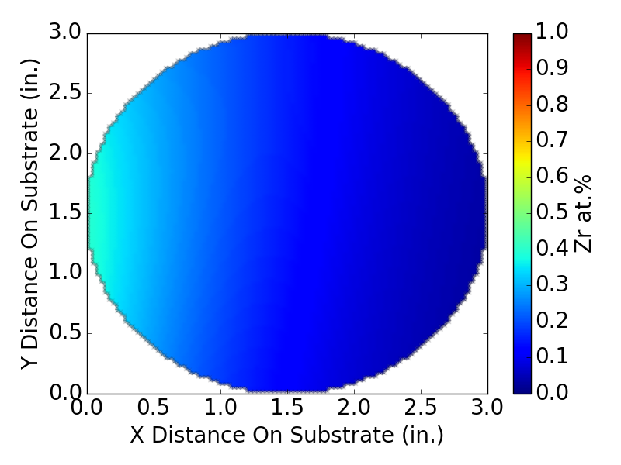
B1 MG-12/2/16-TMW-01 Co-Cr-Zr

Slide 4
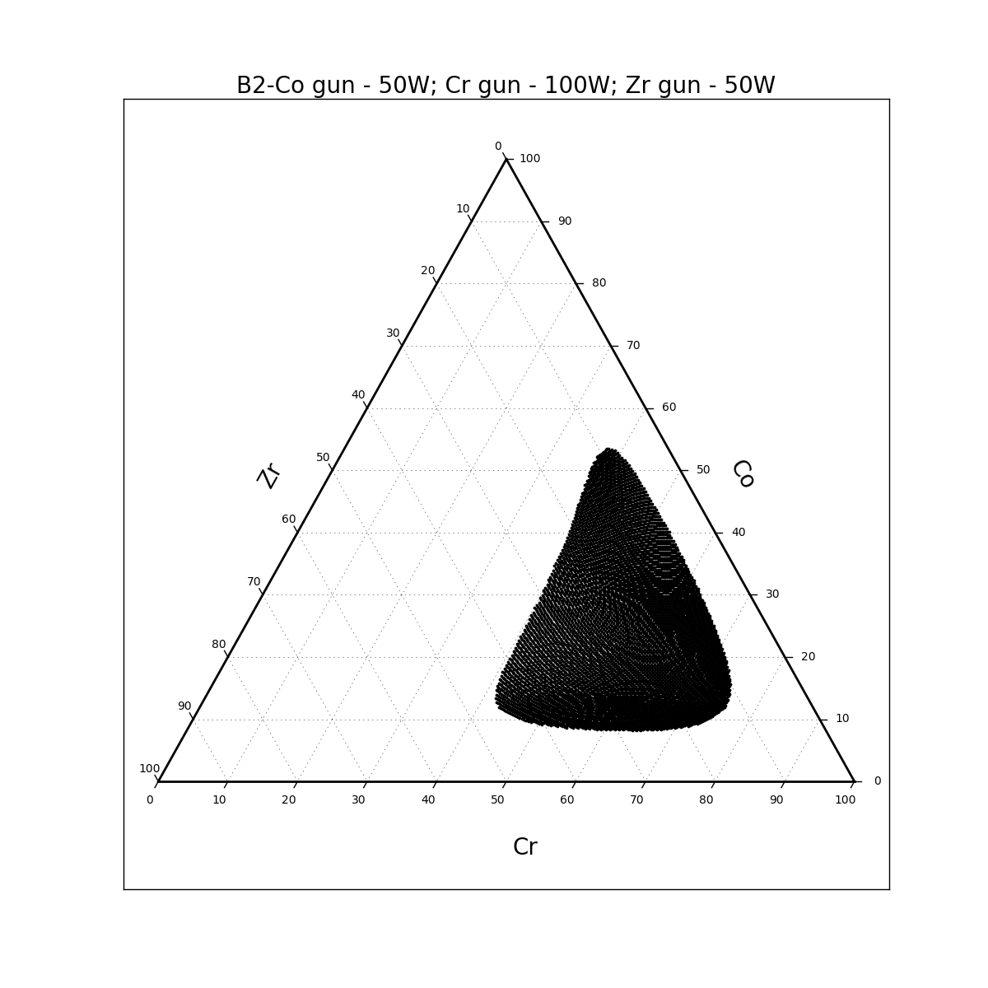
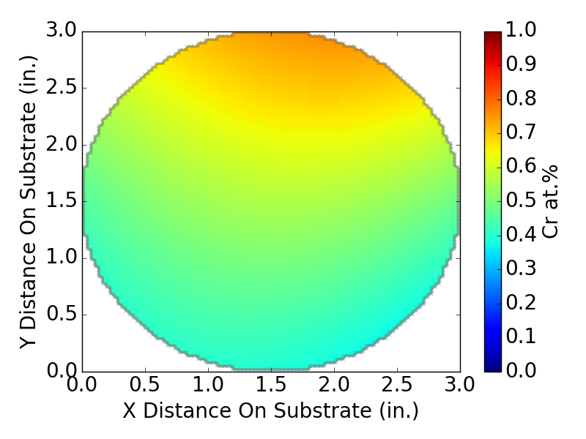
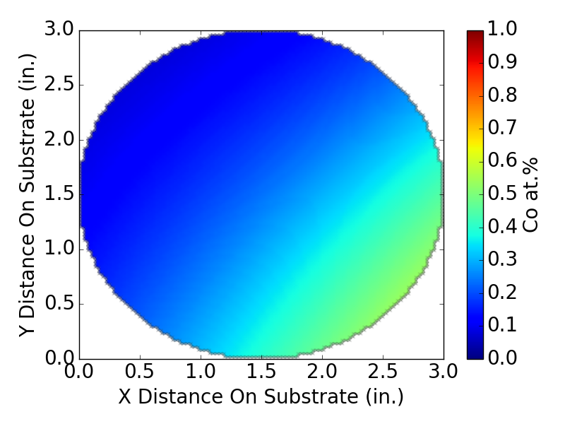
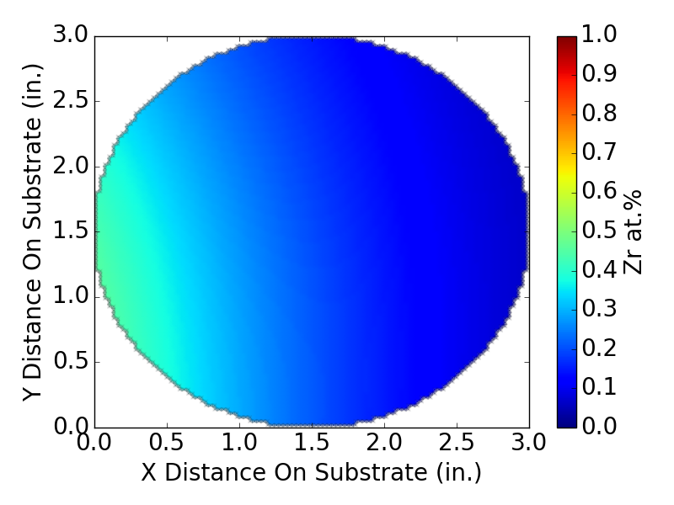
B2 MG-12/2/16-TMW-02 Co-Cr-Zr

Slide 5
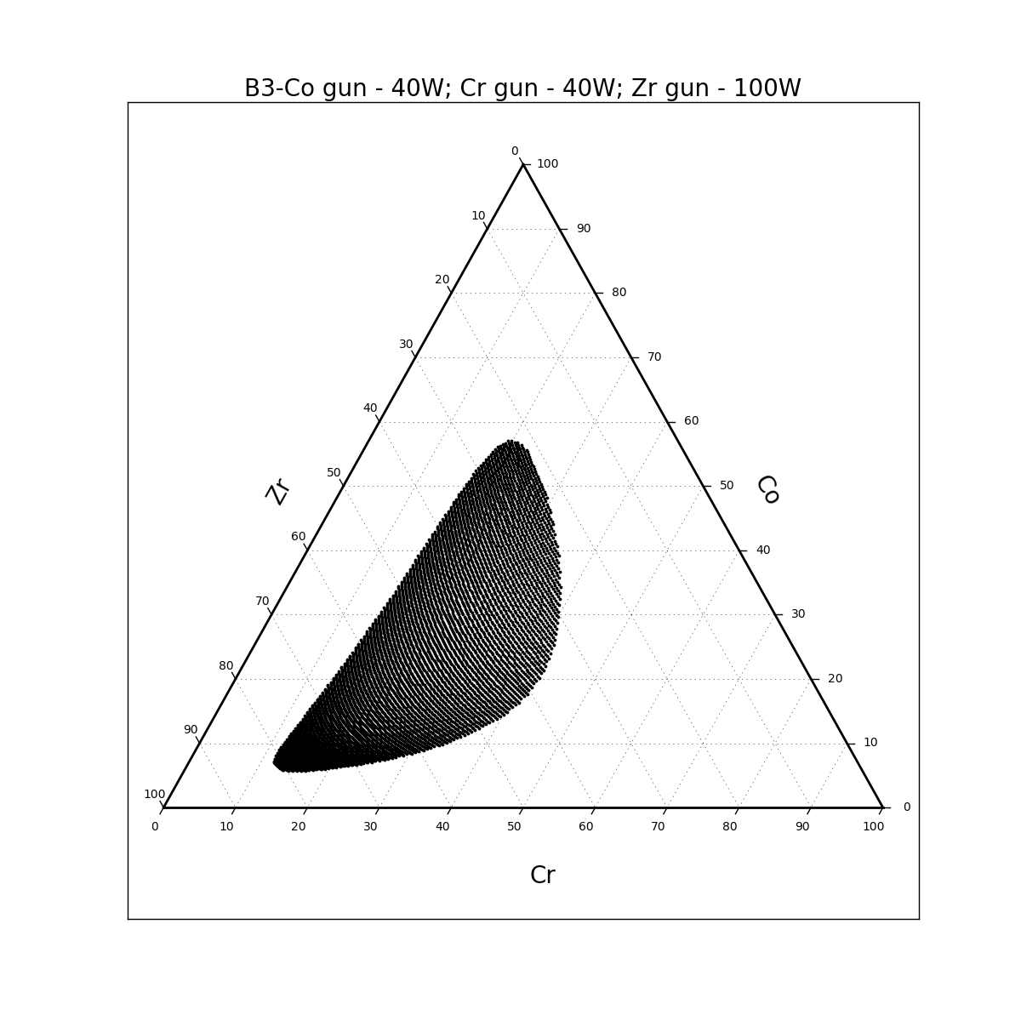
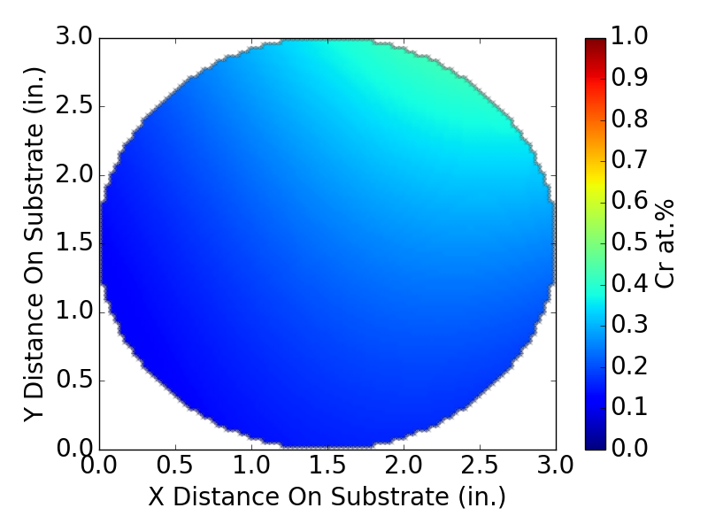
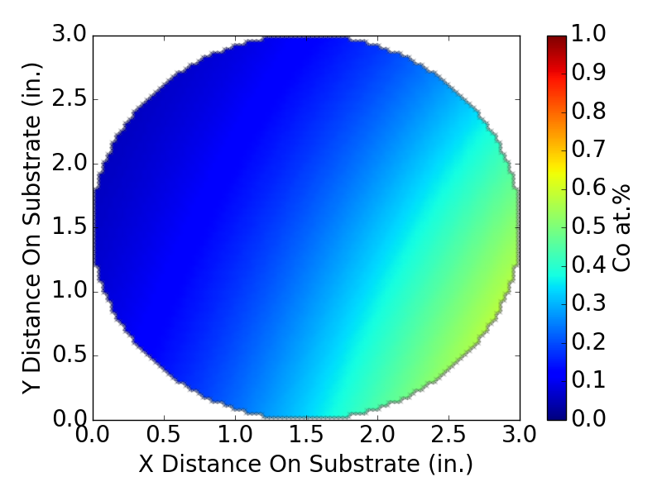
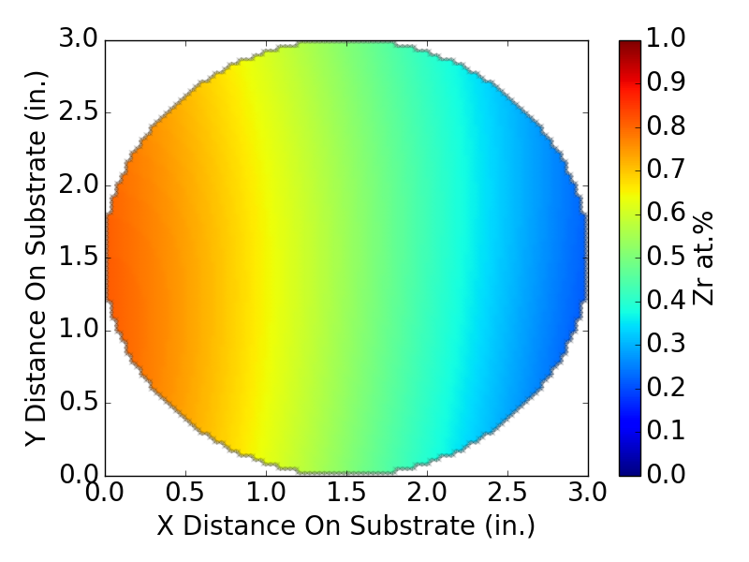
B3 MG-12/2/16-TMW-01 Co-Cr-Zr

Slide 6
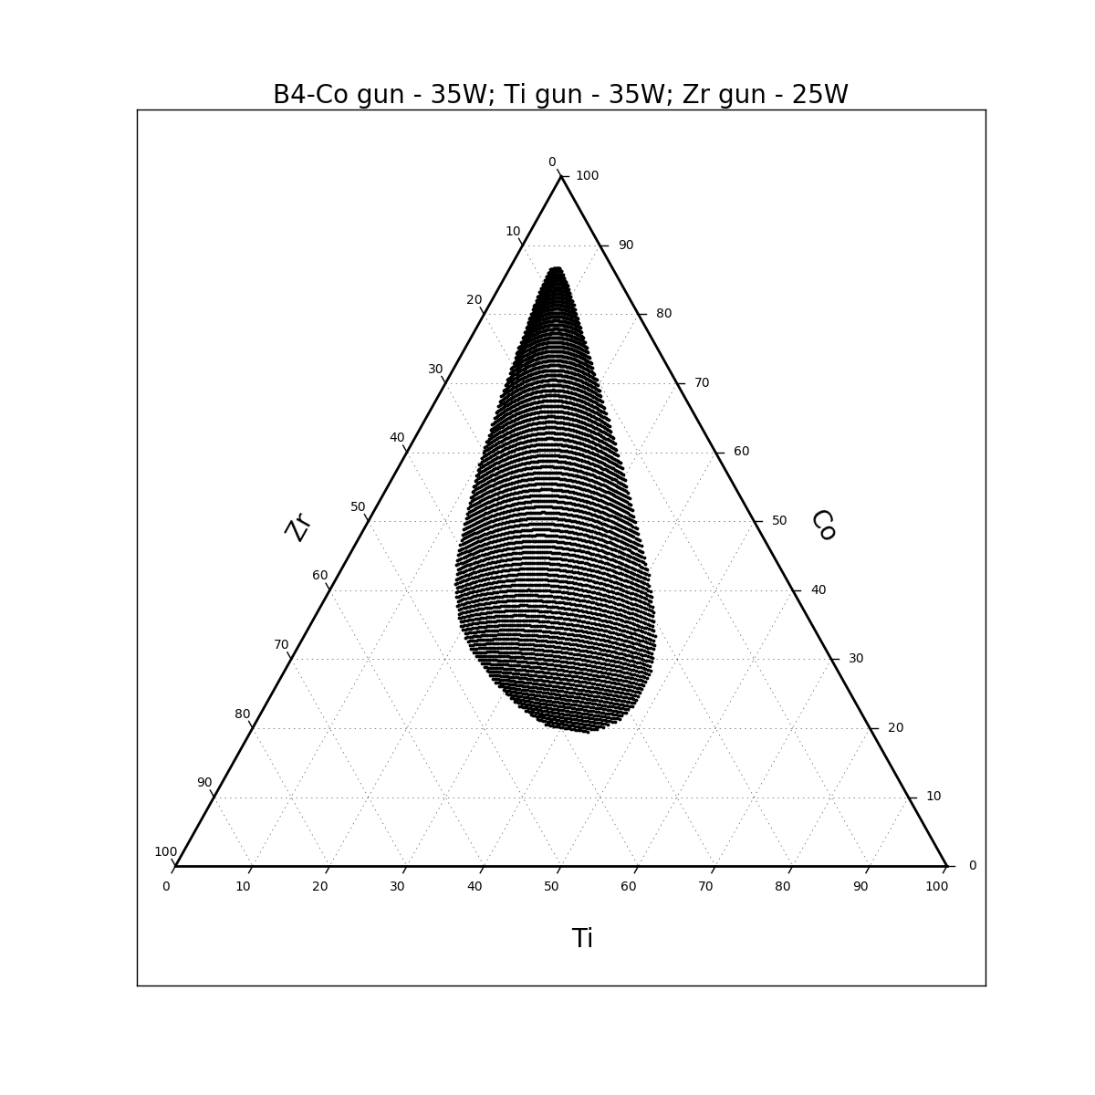
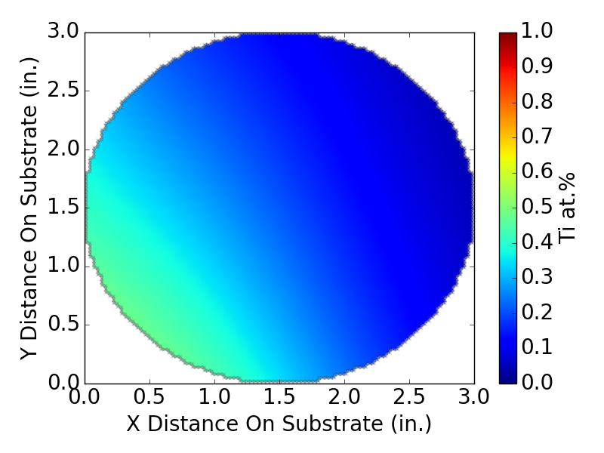
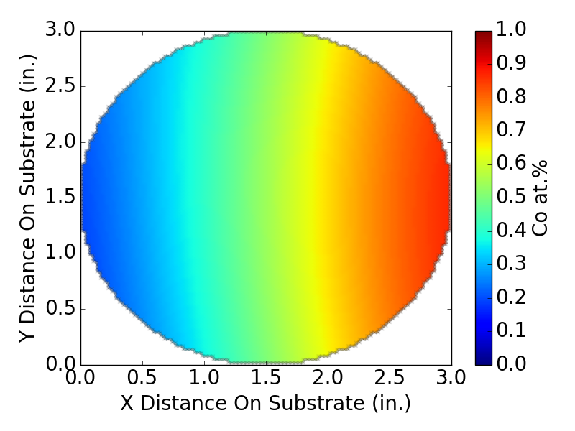
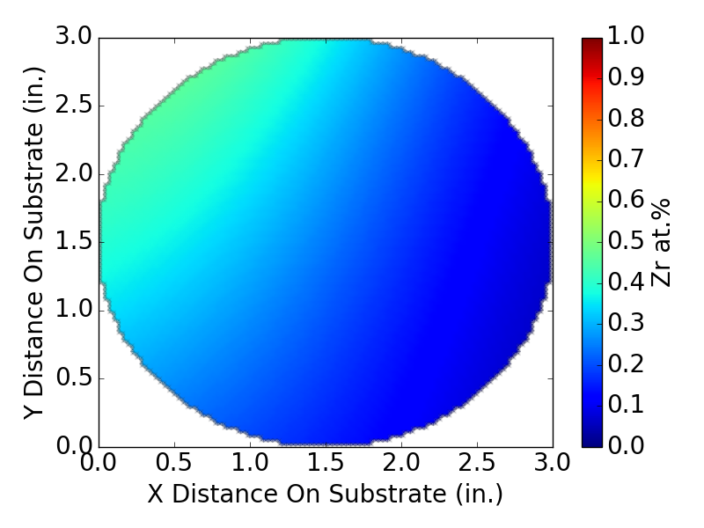
B4 MG-12/8/16-TMW-01 Co-Ti-Zr

Slide 7
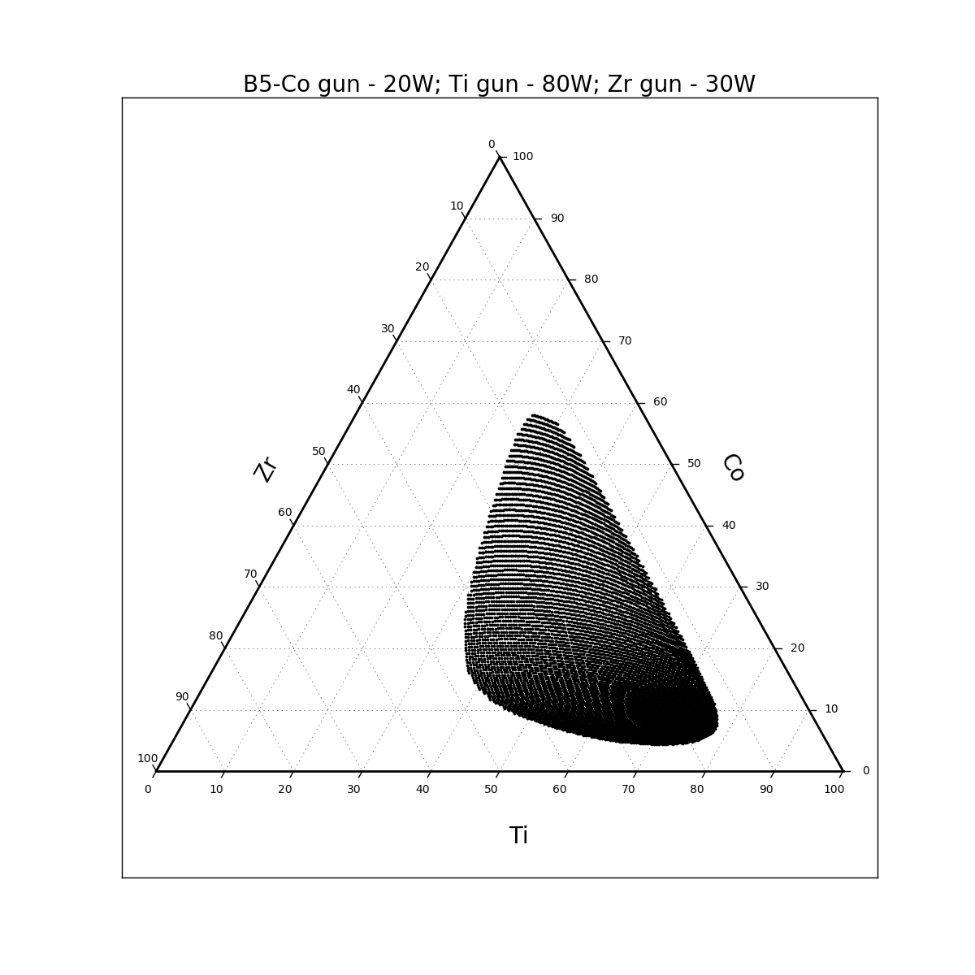
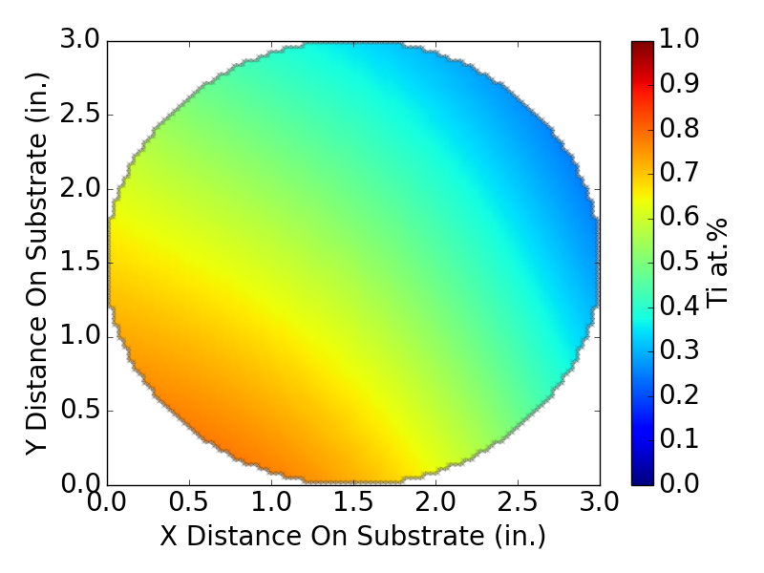
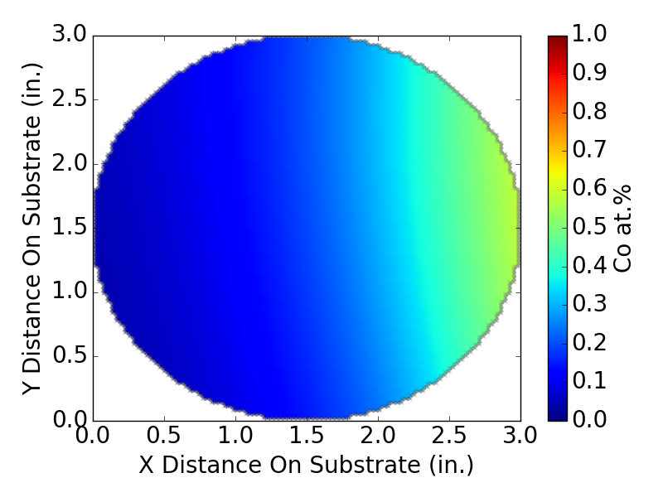
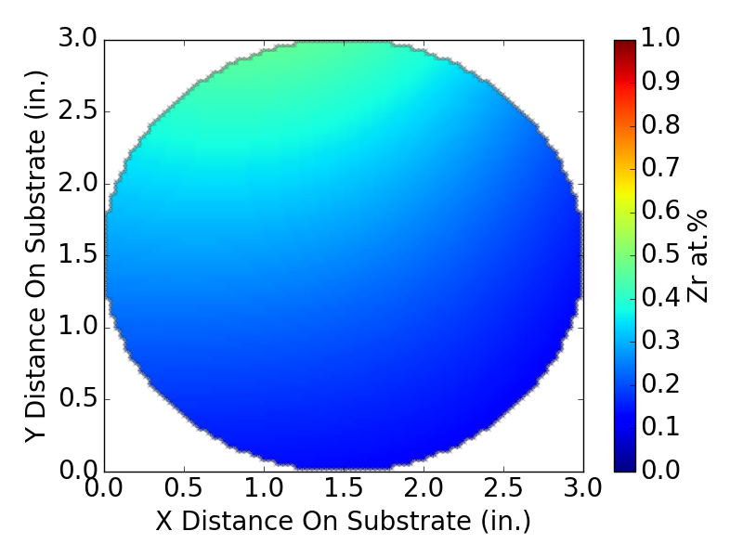
B5 MG-12/12/16-TMW-01 Co-Ti-Zr

Slide 8
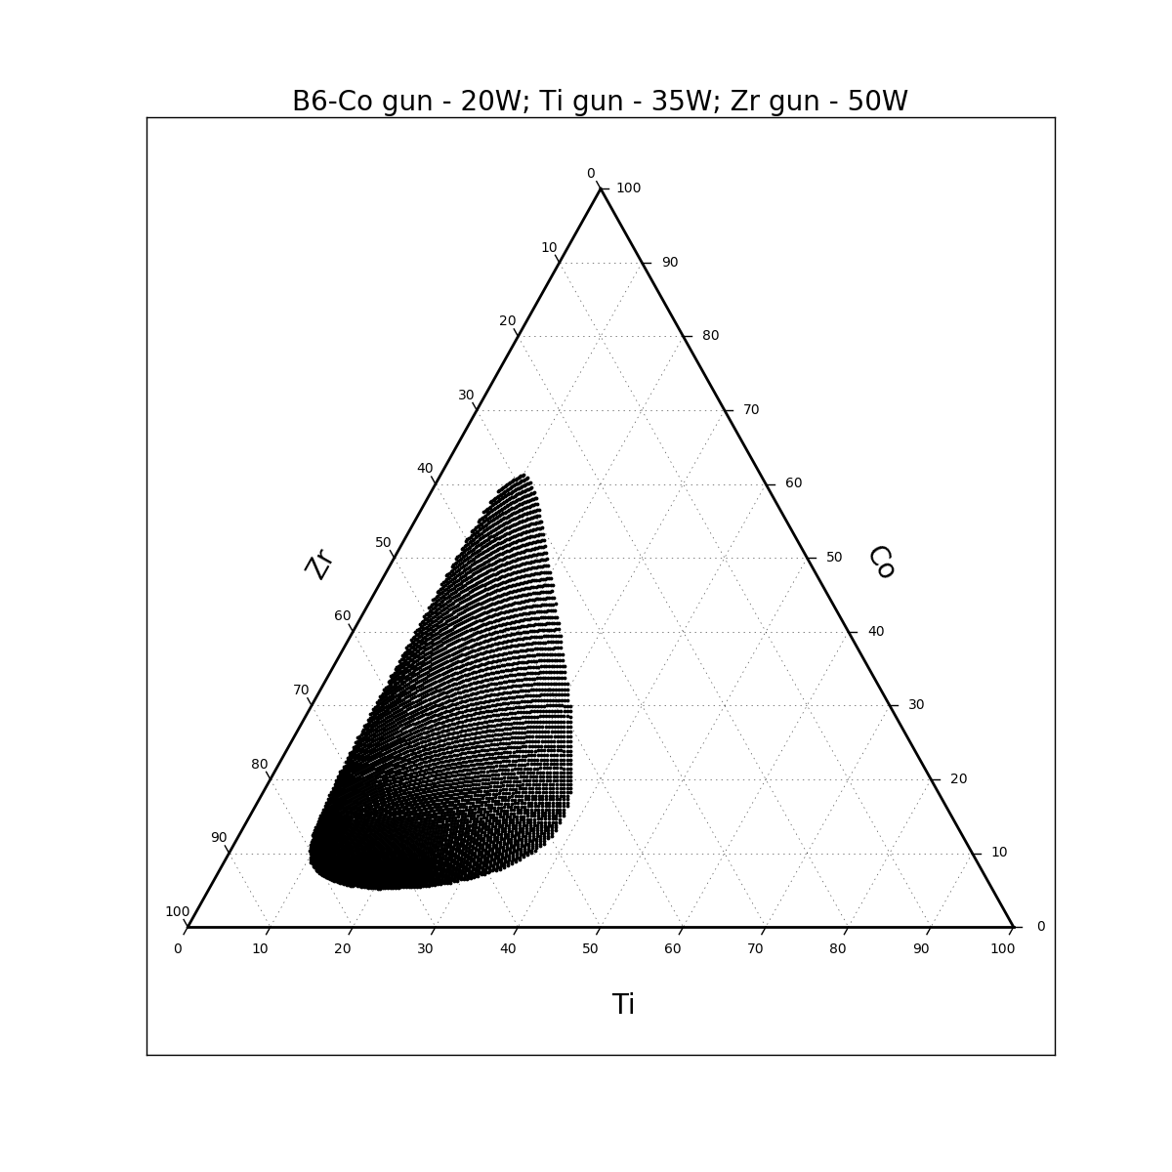
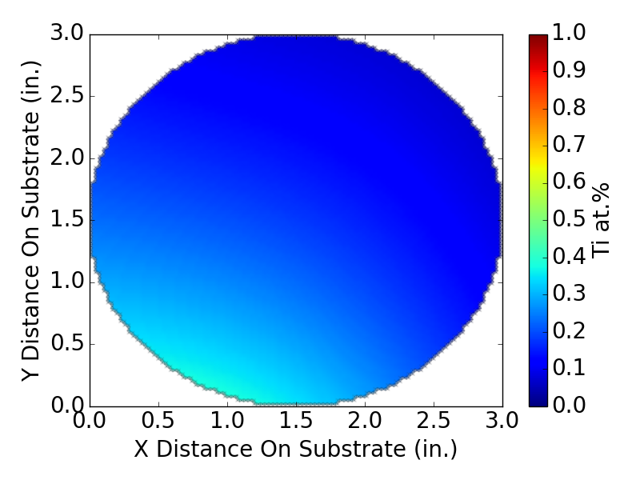
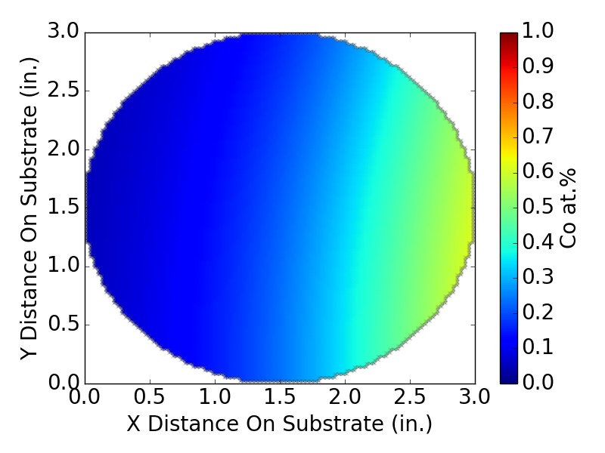
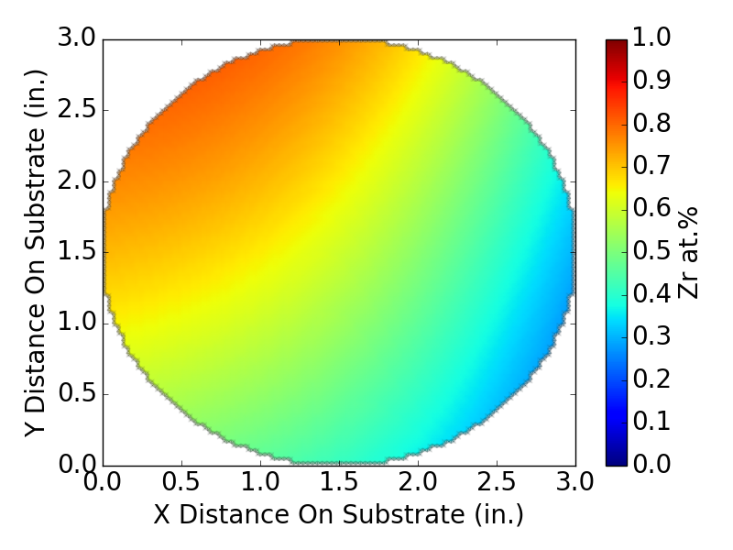
B6 MG-12/13/16-TMW-01 Co-Ti-Zr

Slide 9
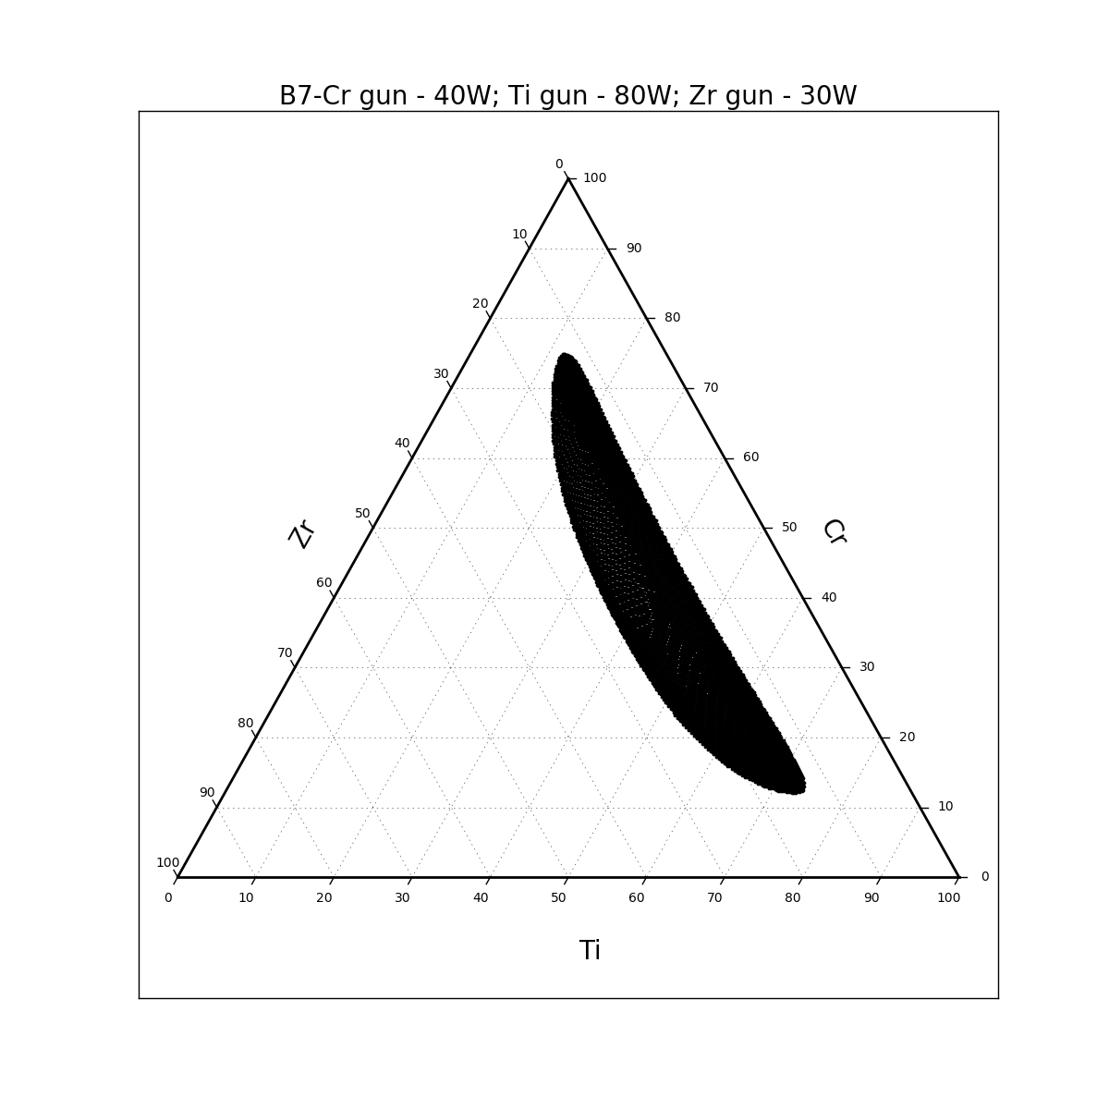
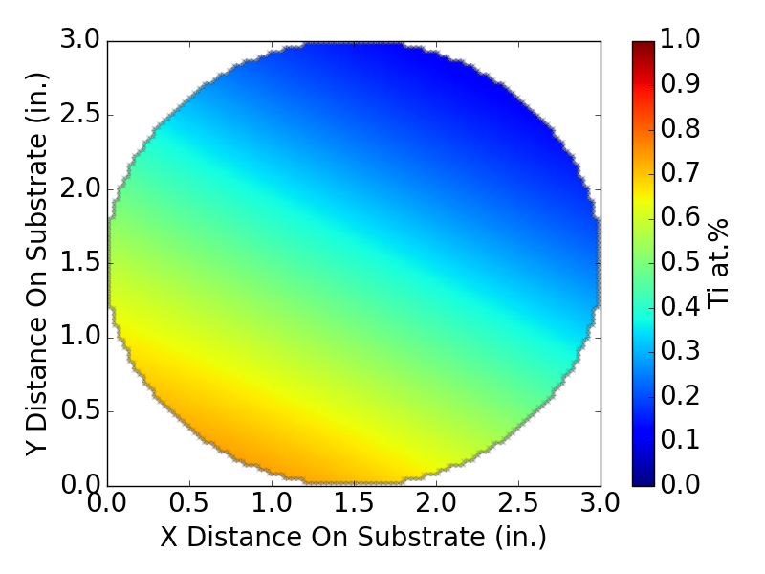
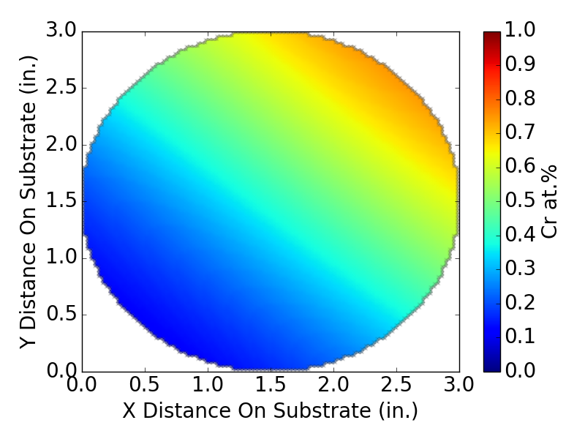
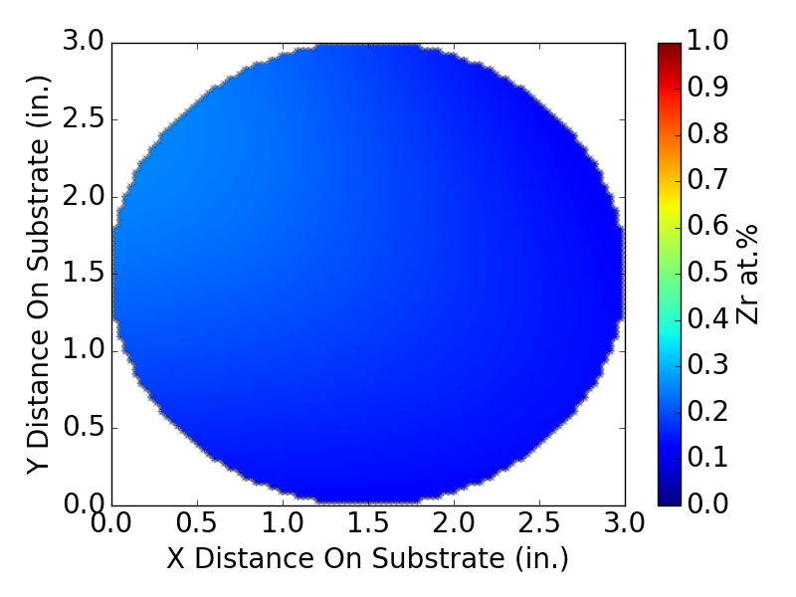
B7 MG-12/16/16-TMW-01 Cr-Ti-Zr

Slide 10
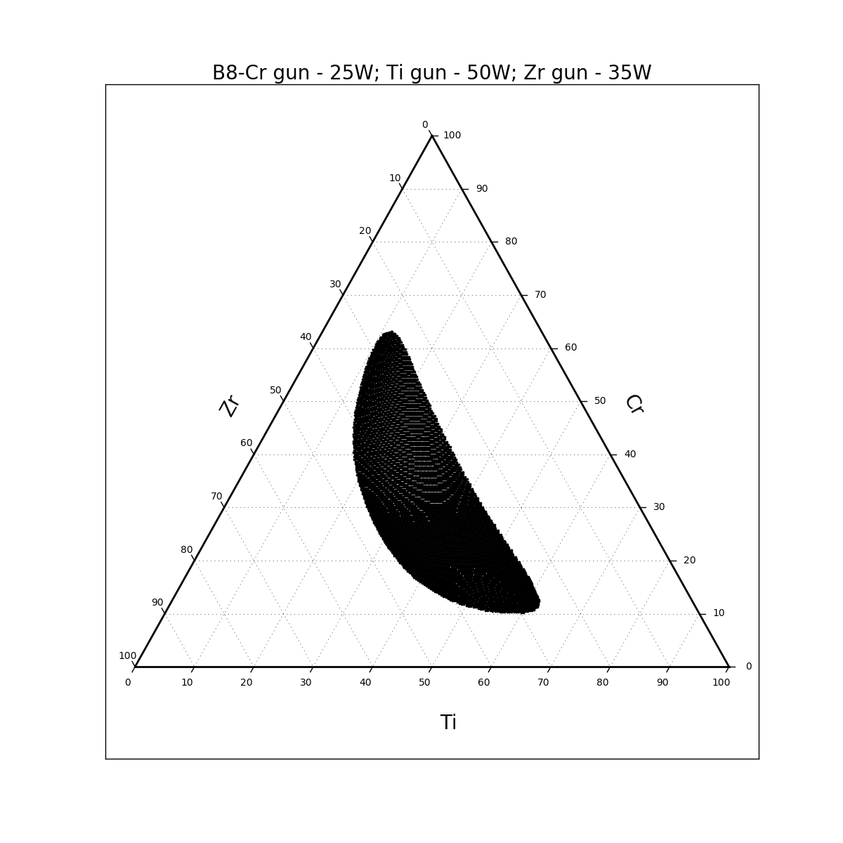
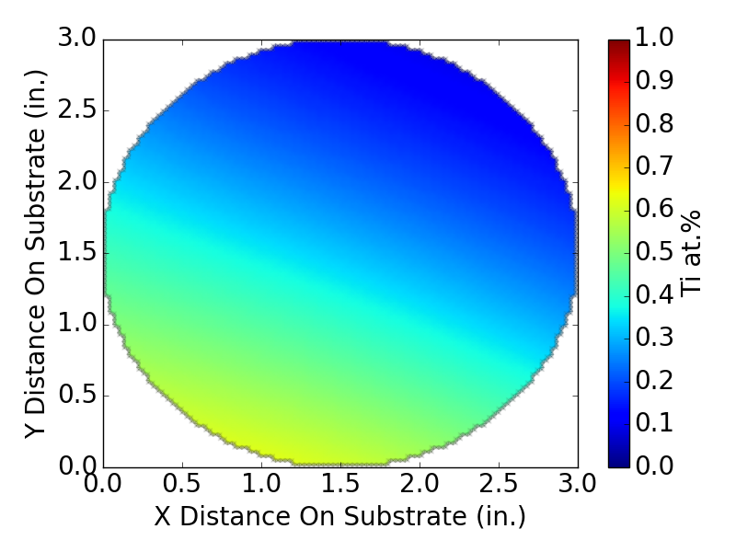
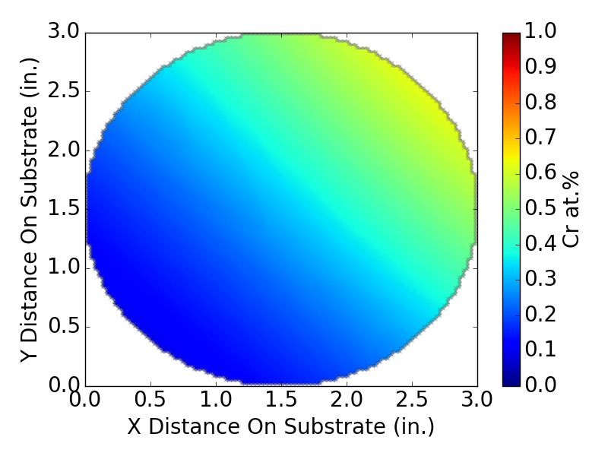
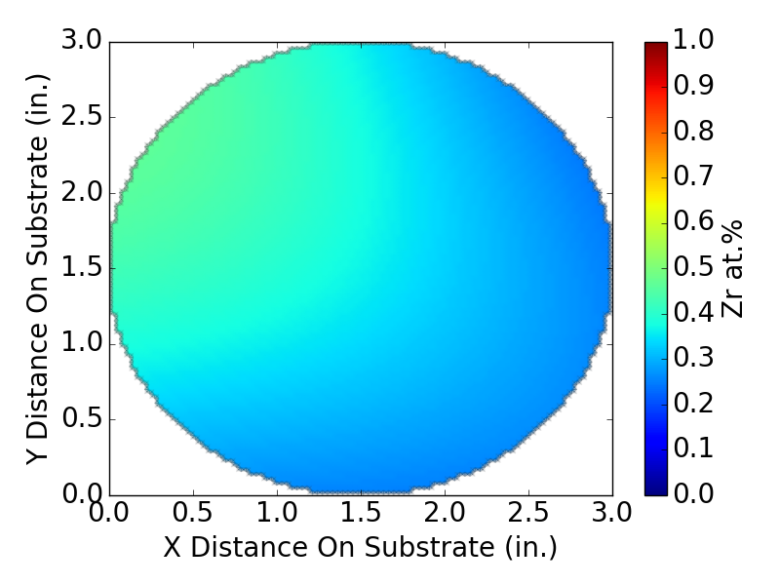
B8 MG-12/16/16-TMW-02 Cr-Ti-Zr

Slide 11
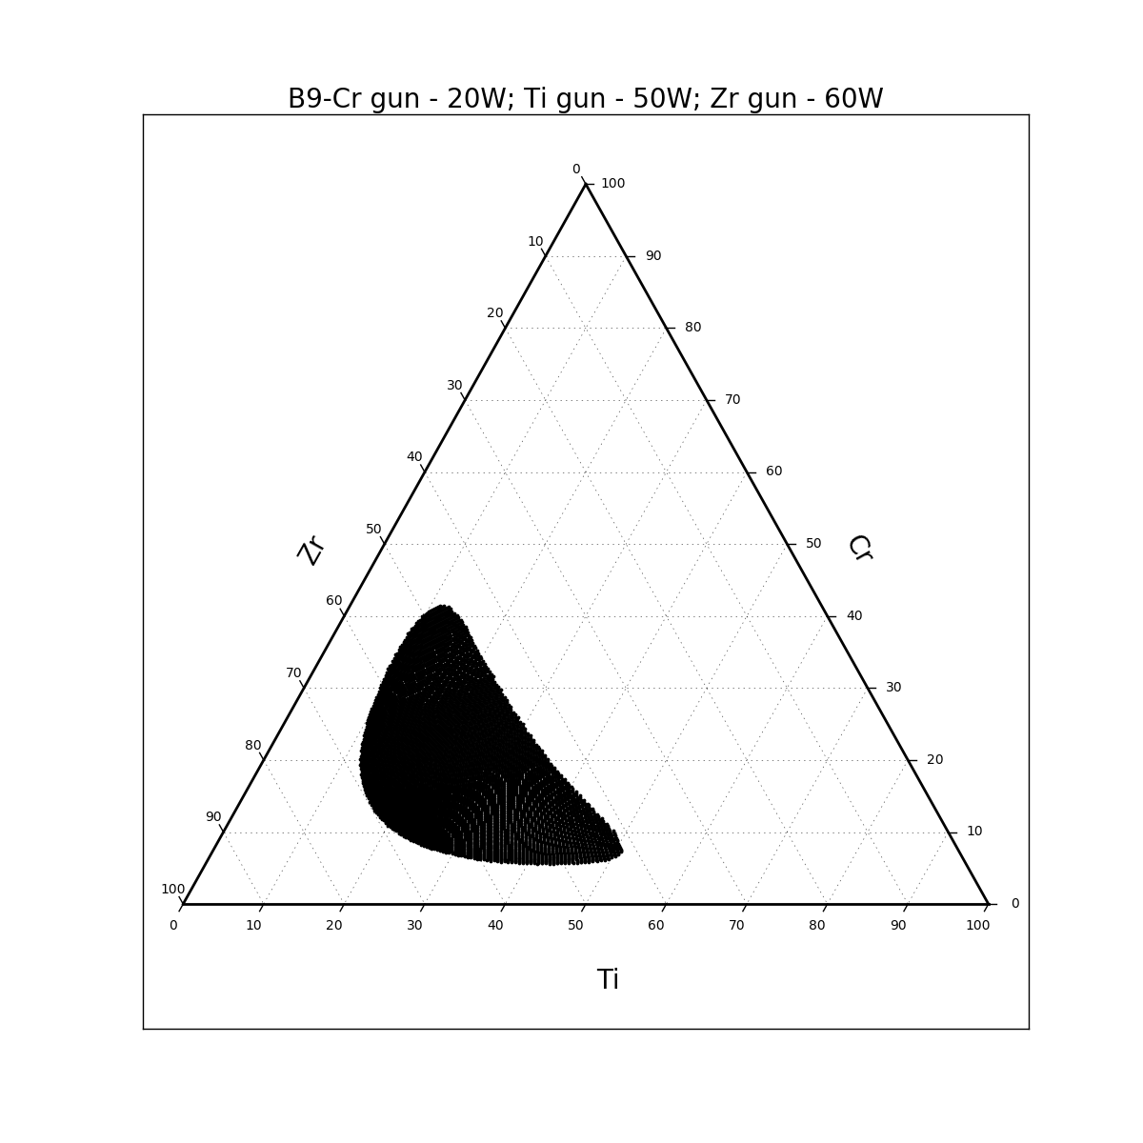
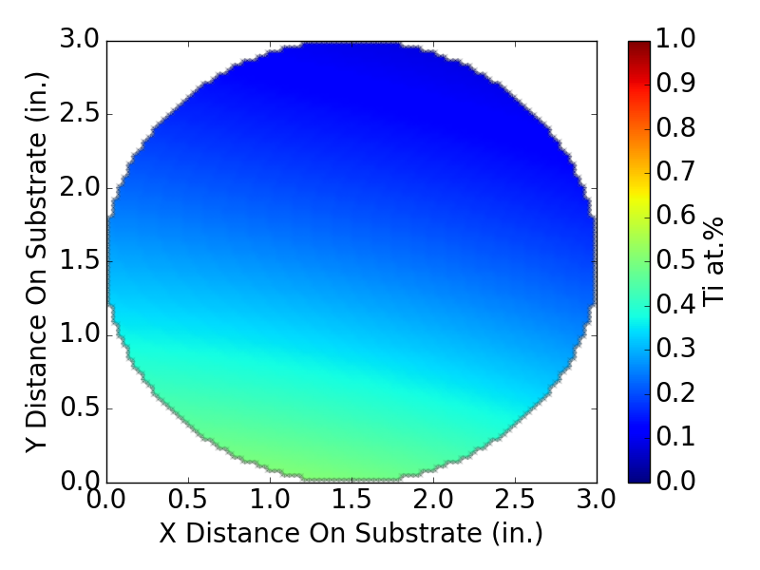
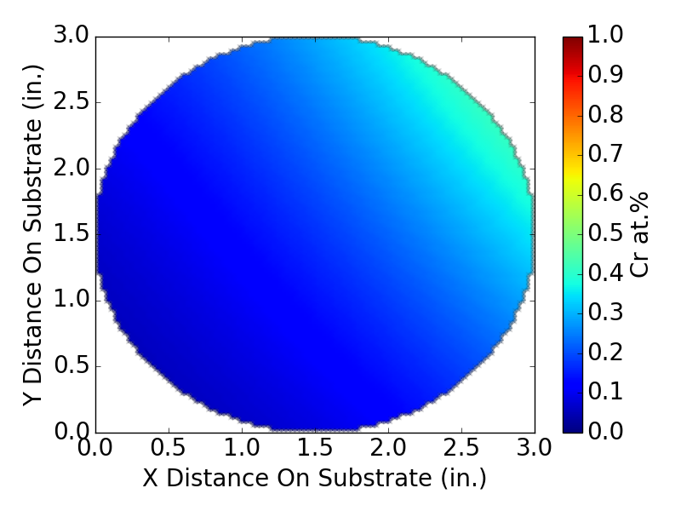
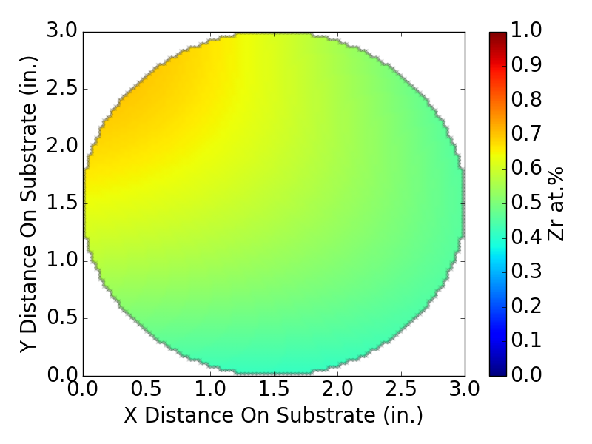
B9 MG-12/19/16-TMW-01 Cr-Ti-Zr

Slide 12
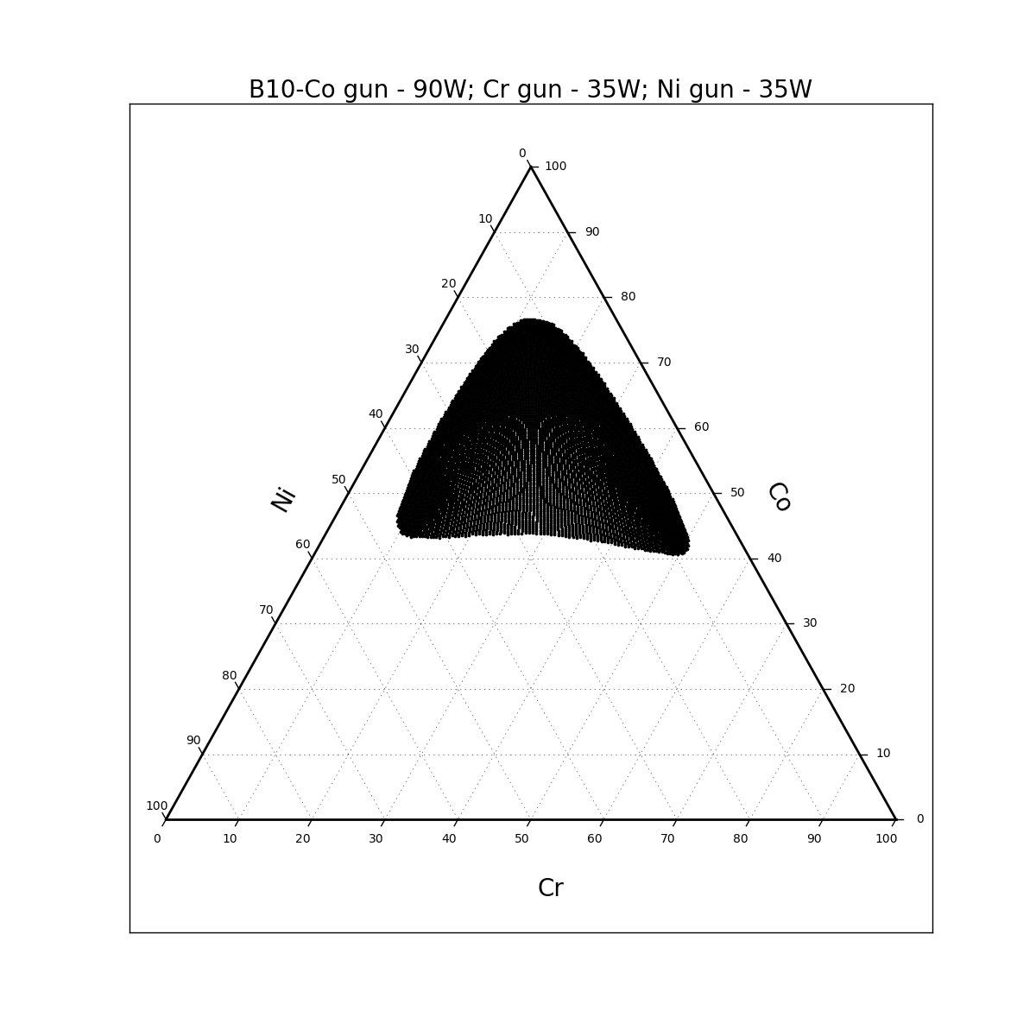
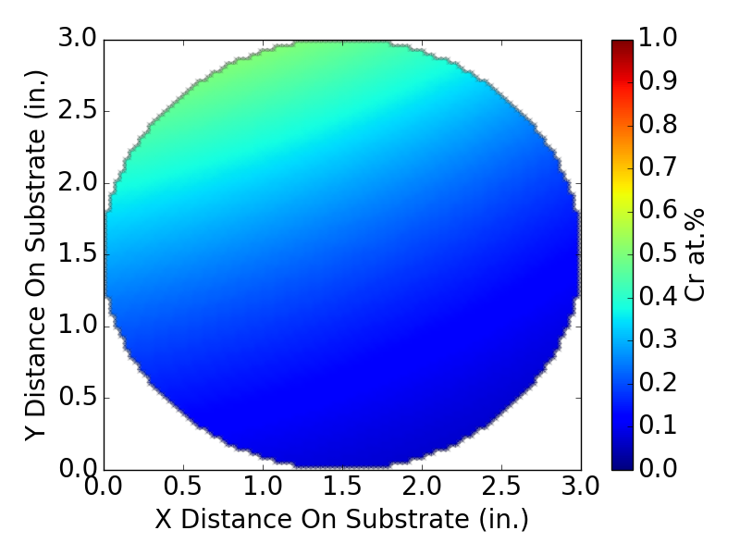
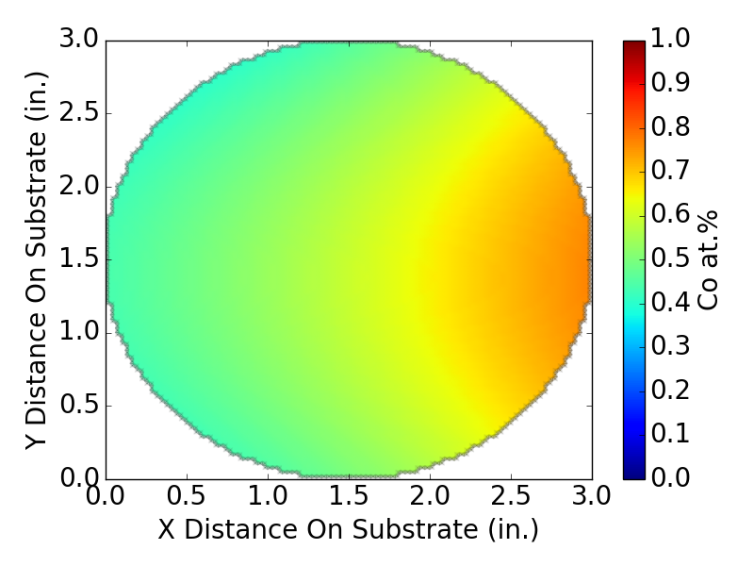
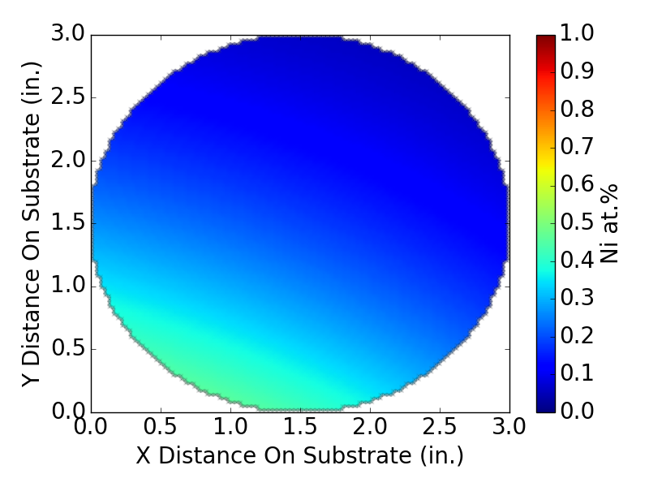
B10 MG-12/19/16-TMW-02 Co-Cr-Ni

Slide 13
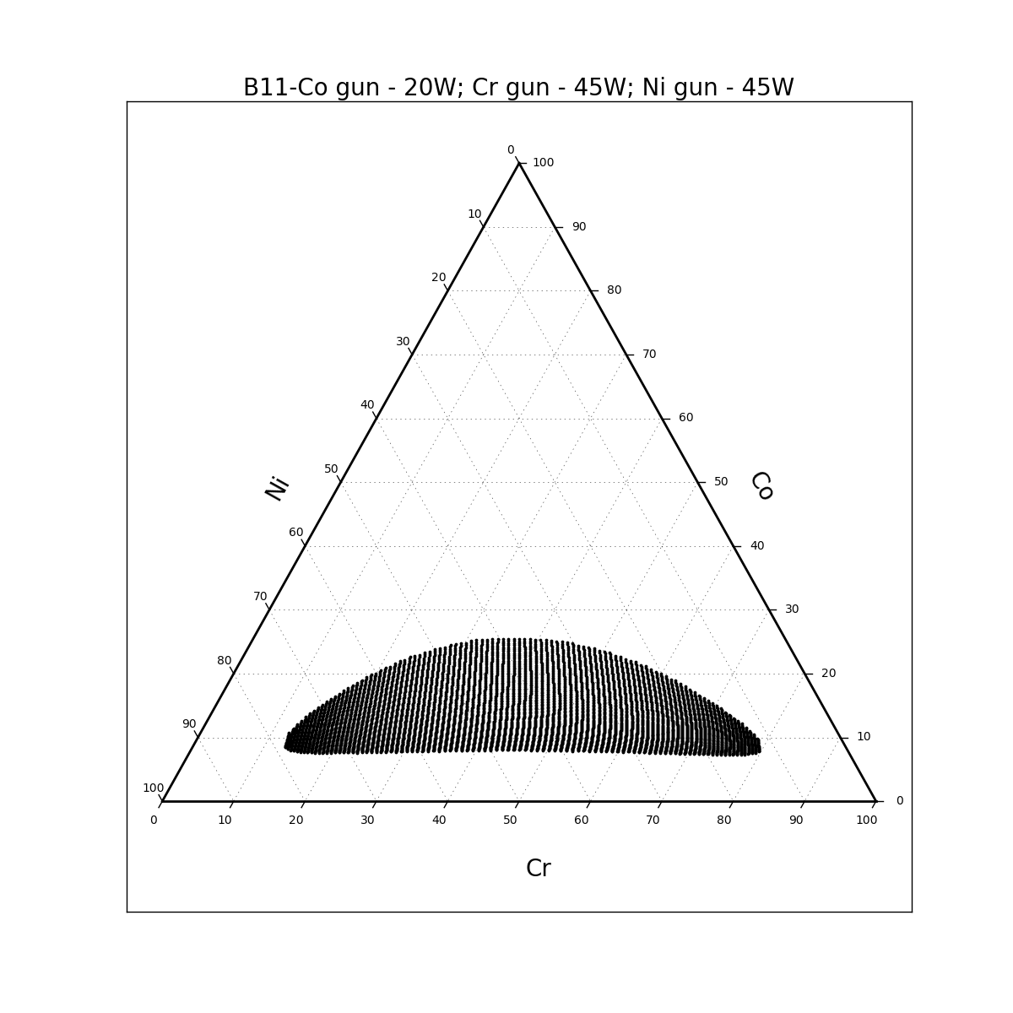
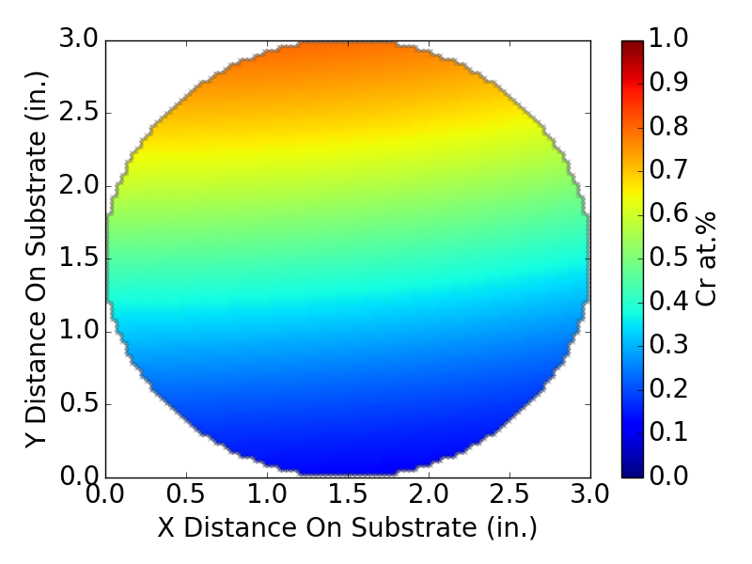
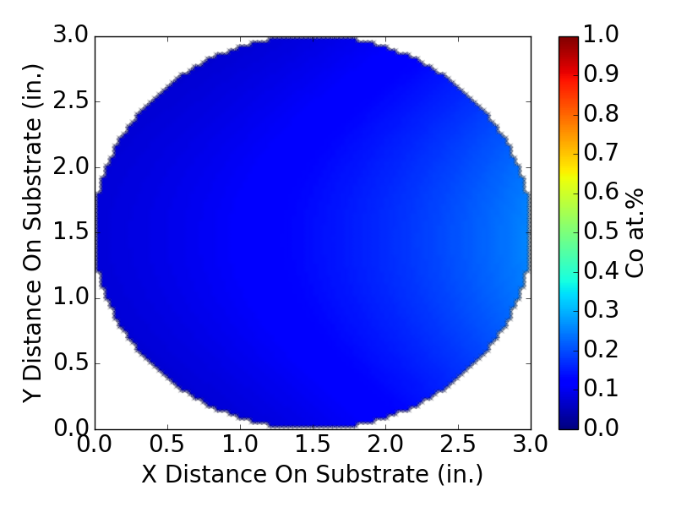
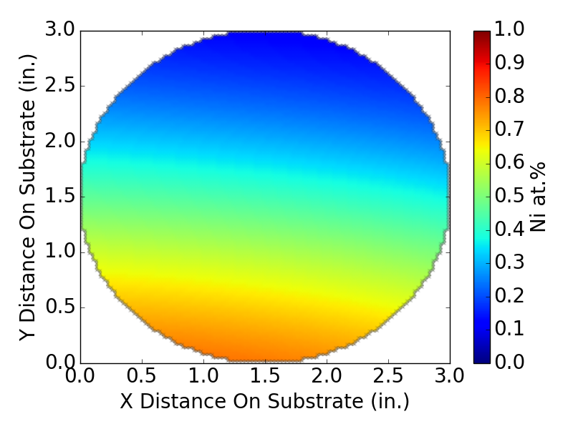
B11 MG-12/20/16-TMW-01 Co-Cr-Ni

Slide 14
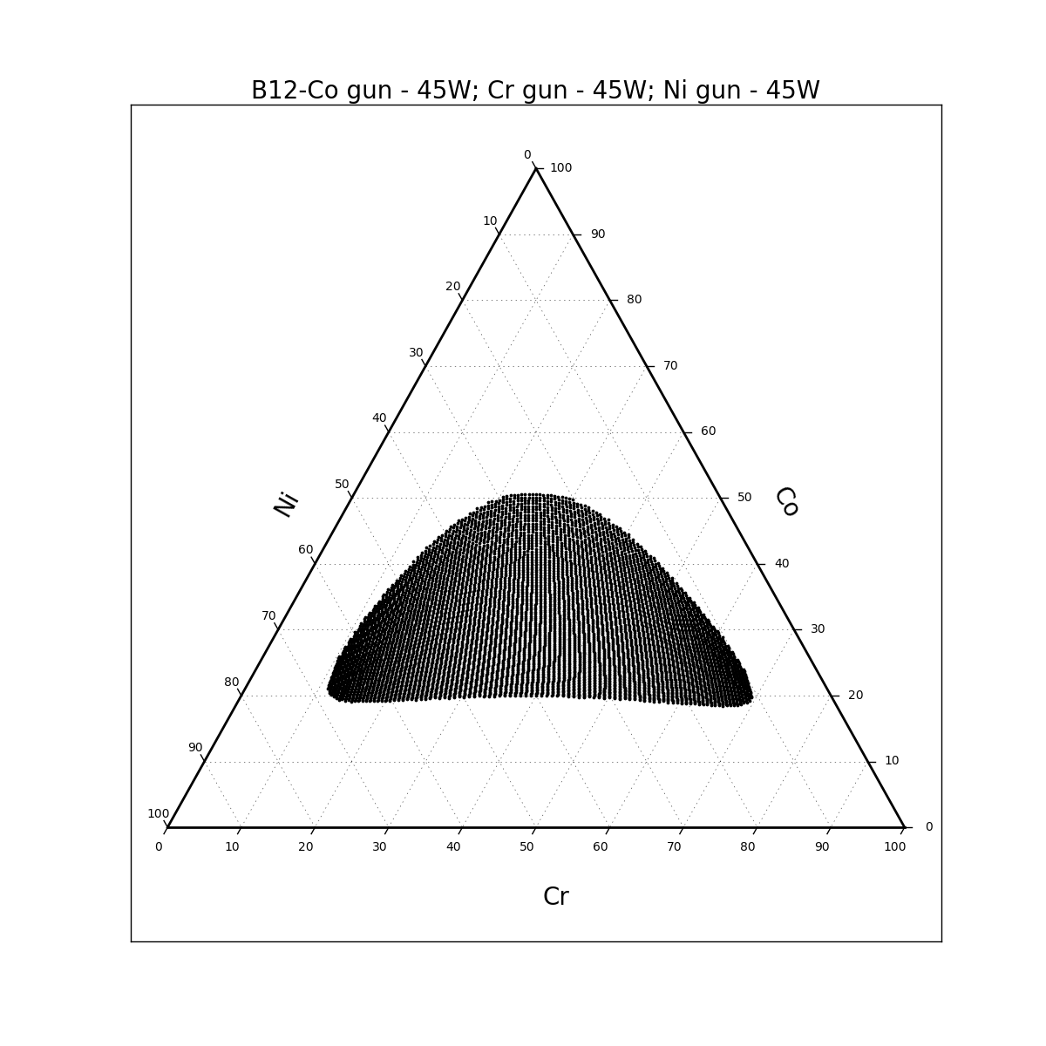
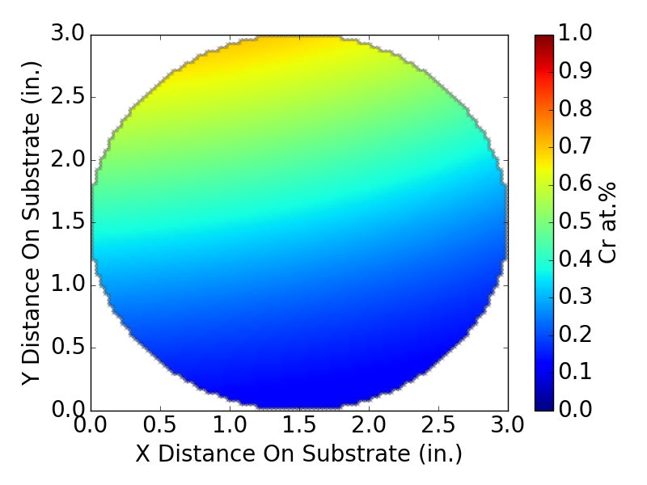
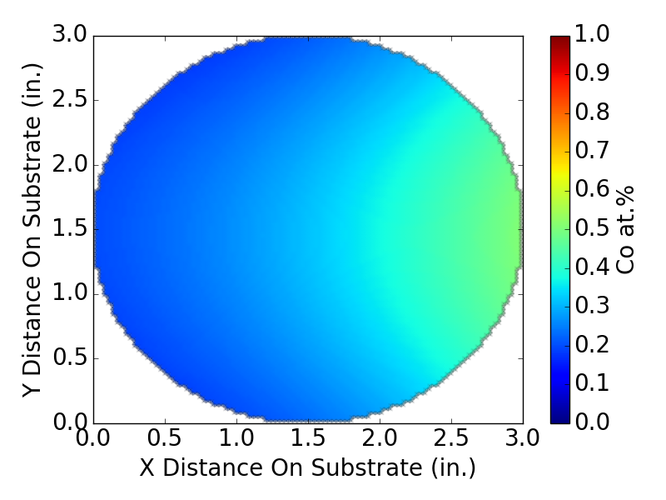
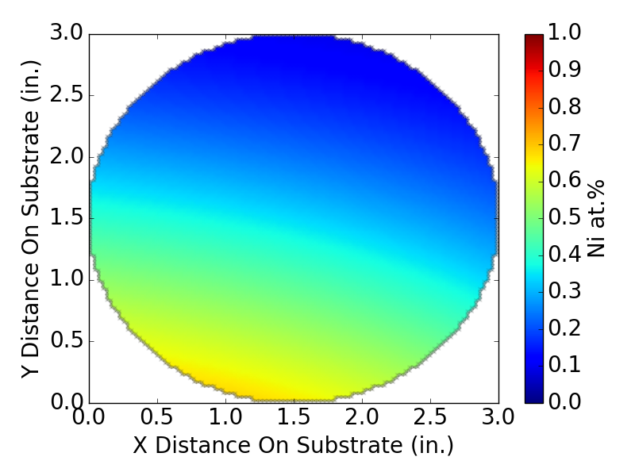
B12 MG-12/20/16-TMW-02 Co-Cr-Ni

Slide 15
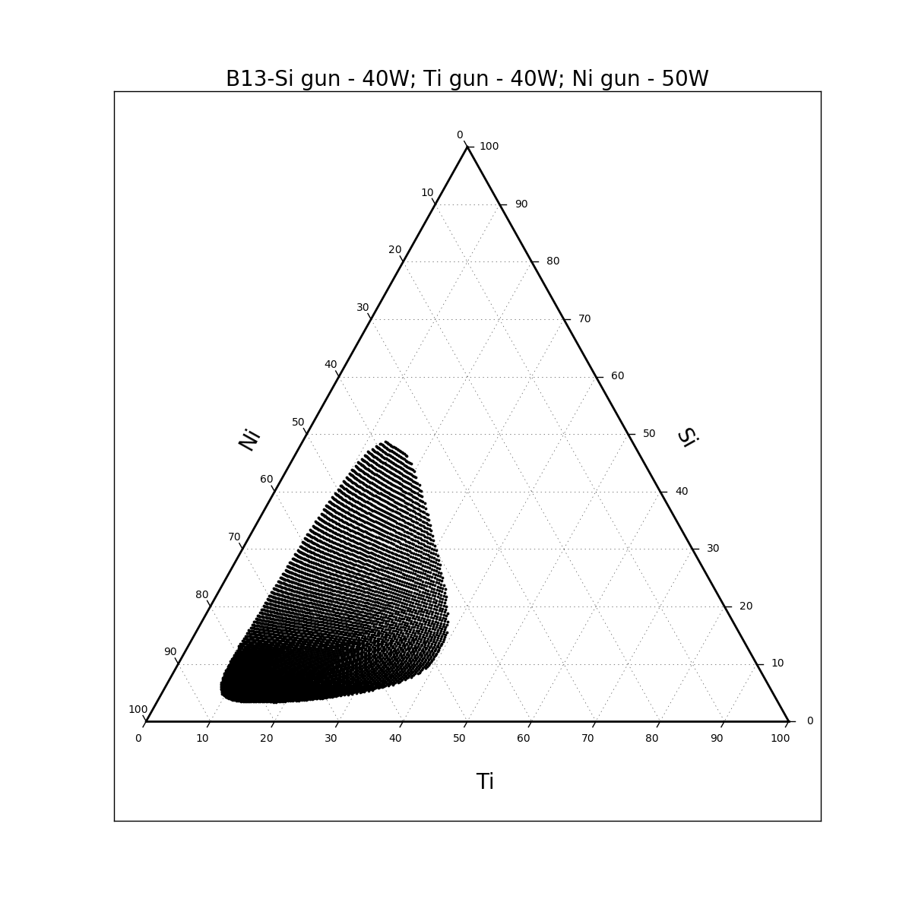
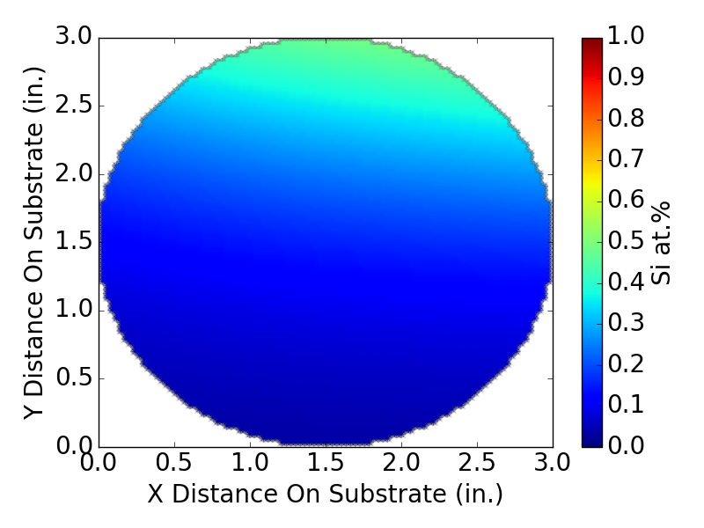


B13 MG-1/6/17-TMW-01 Ni-Si-Ti

Slide 16




B14 MG-1/6/17-TMW-02 Ni-Si-Ti

Slide 17




B15 MG-1/9/17-TMW-01 Ni-Si-Ti

Slide 18




B16 MG-1/9/17-TMW-02 Ni-Nb-Ti

Slide 19




B17 MG-1/10/17-TMW-01 Ni-Nb-Ti

Slide 20




B18 MG-1/10/17-TMW-02 Ni-Nb-Ti

Slide 21




B19 MG-1/11/17-TMW-01 Fe-Nb-Ti

Slide 22




B20 MG-1/11/17-TMW-02 Fe-Nb-Ti

Slide 23




B21 MG-1/12/17-TMW-01 Fe-Nb-Ti

Slide 24




B22 MG-8/22/16-TMW-01 Co-Fe-V

Slide 25




B23 MG-8/22/16-TMW-02 Co-Fe-V

Slide 26




B24 MG-8/26/16-TMW-01 Co-Fe-V

